Slide 1
SQL Processing

Slide 2
Data Transformation Process
Data Integration
Data Cleaning
Calendar Table Creation
Handling Redundant Values
Final Data Model
Filling NULL values in Color column with 'Black'
Joining SalesOrderHeader and SalesOrderDetail tables
Building a Calendar Table using Power Query
Preparing a clean and consistent dataset for analysis
Fixing redundancy in Sales Fact Table

Slide 3
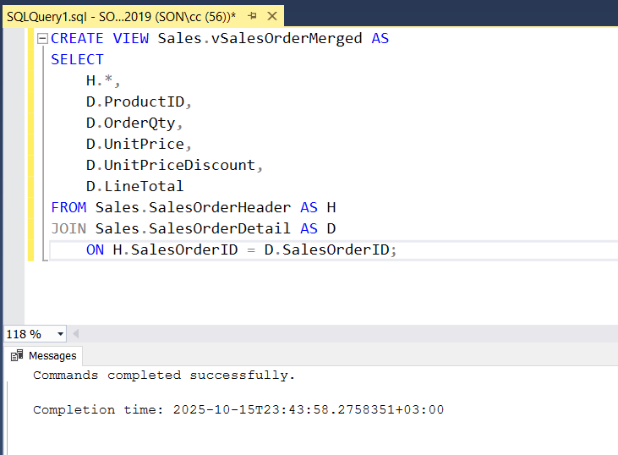

Slide 4
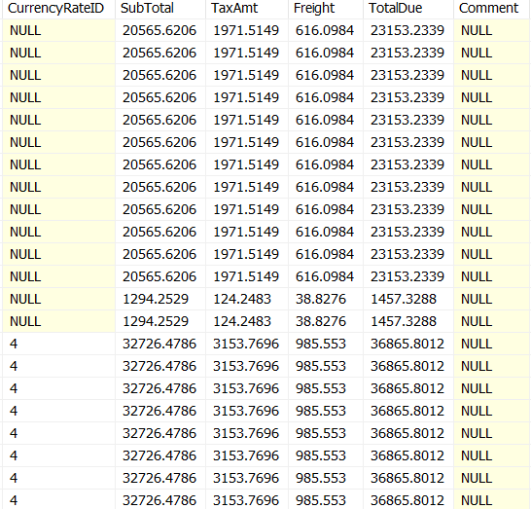

Slide 5
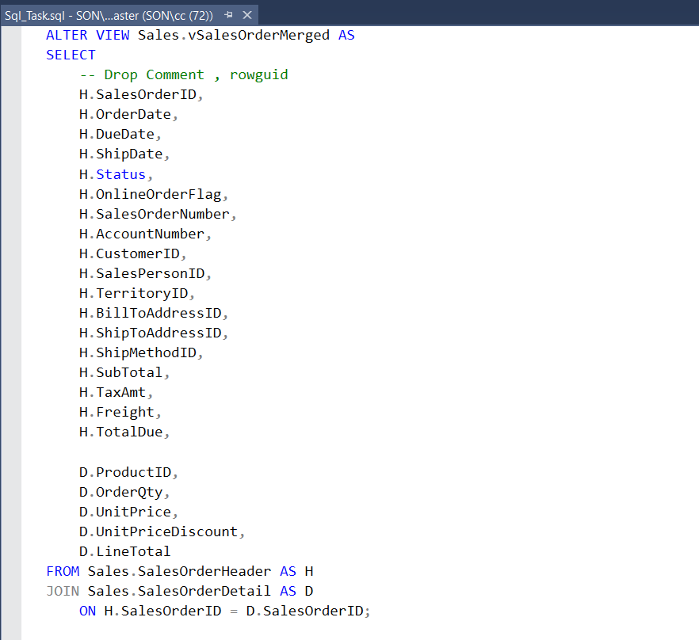

Slide 6
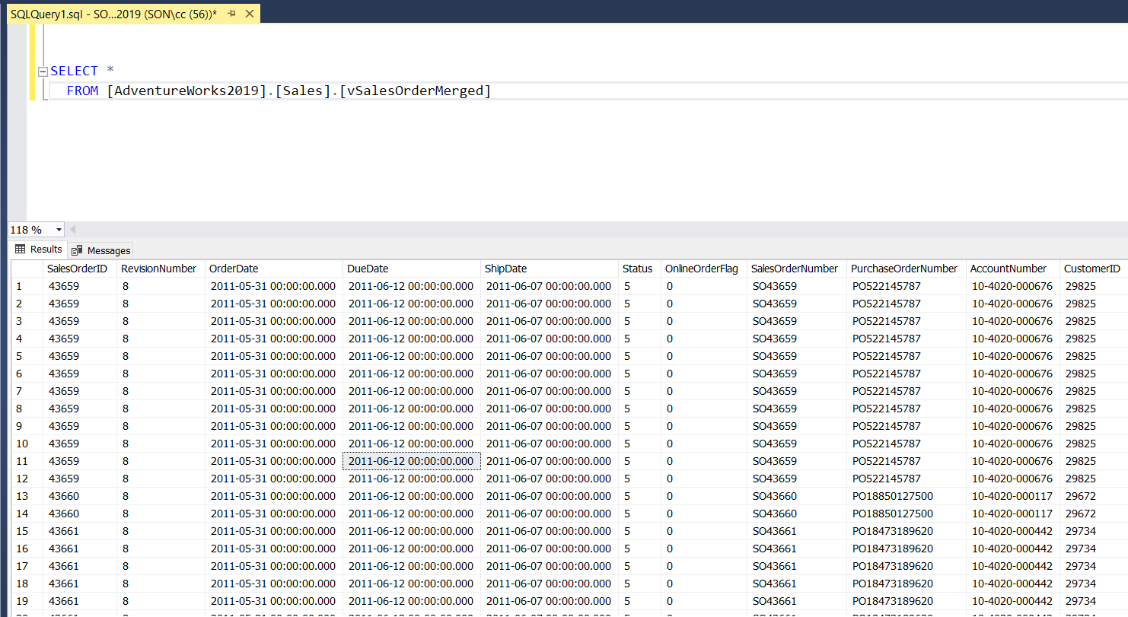

Slide 7
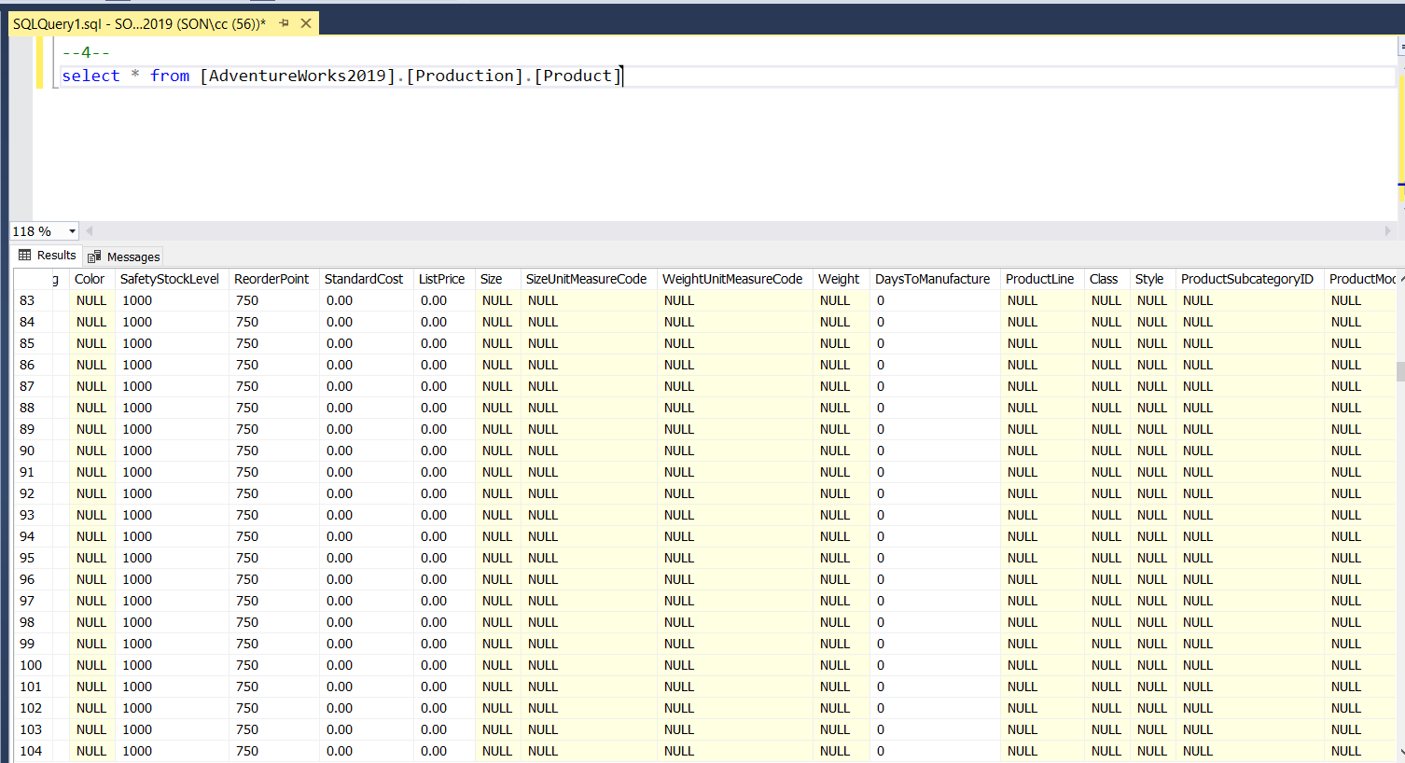

Slide 8
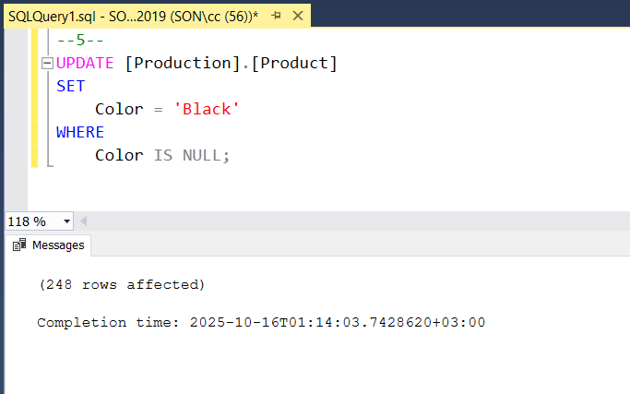

Slide 9
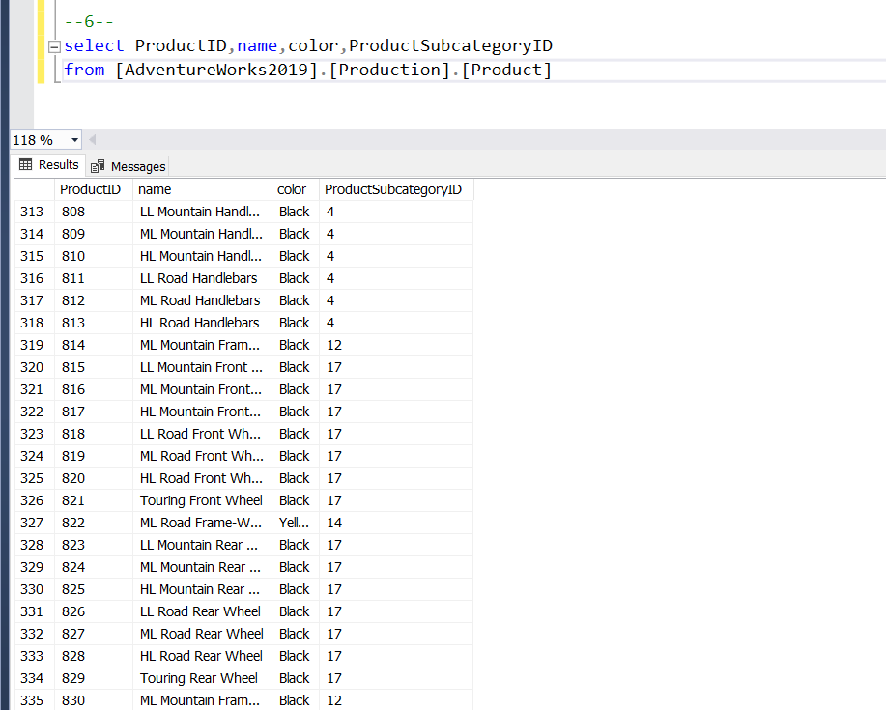

Slide 10
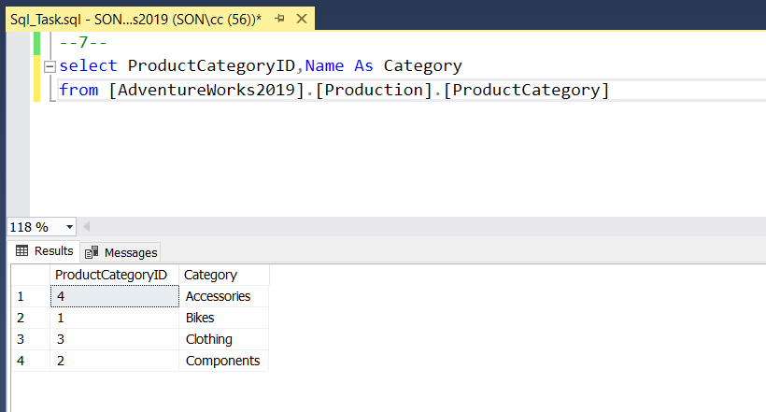

Slide 11
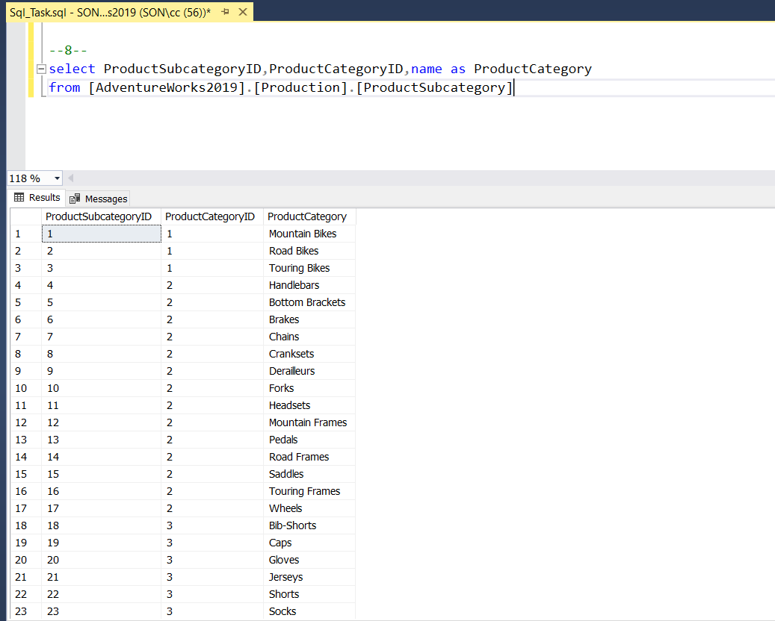

Slide 12
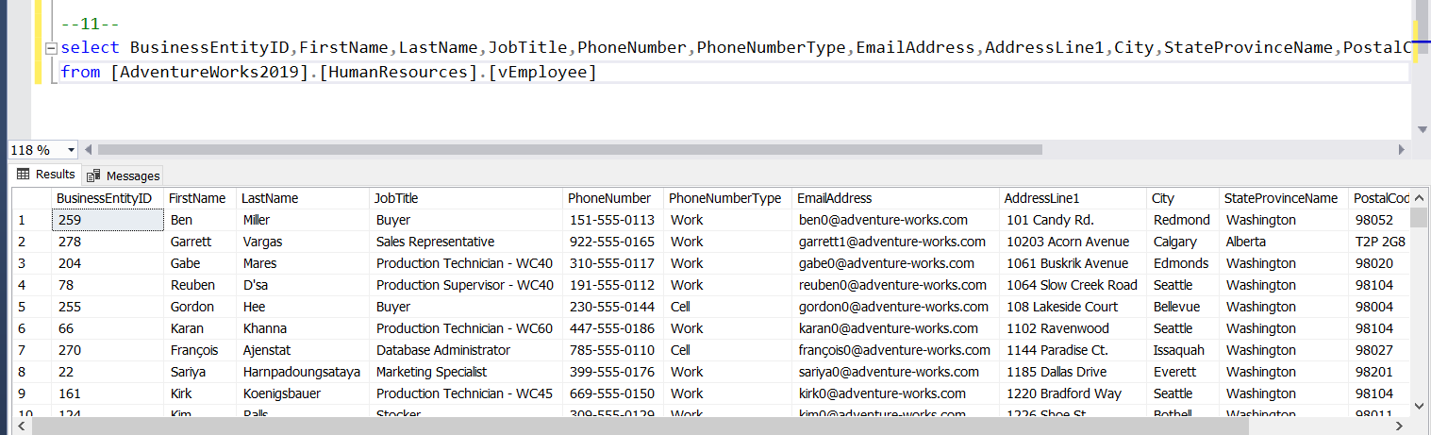

Slide 13
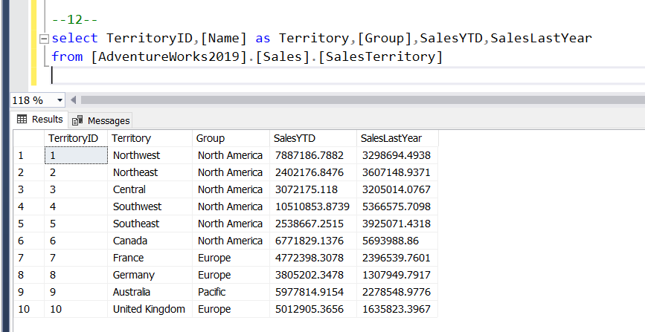

Slide 14
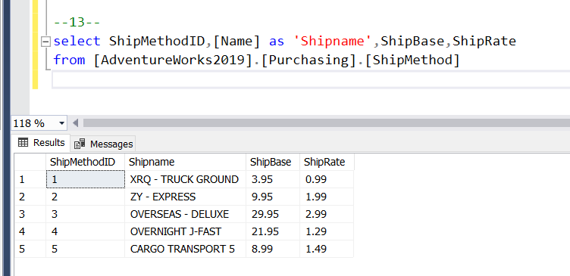

Slide 15
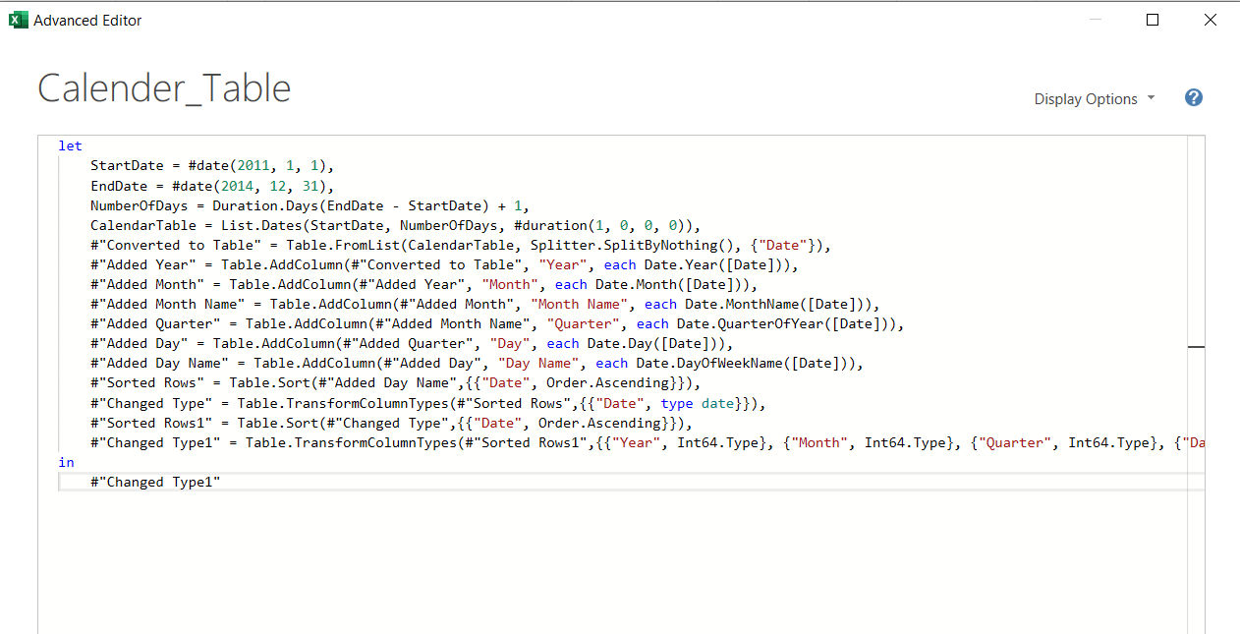

Slide 16
